Slide 1
DBMS PROJECT -1
PROJECT OF
Database for library management system (LMS)

Slide 2
TEAM MEMBERS
Name : Anirudh pabbaraju
Registration Number : (22CSB0A10)
Email id : ap22csb0a10@student.nitw.ac.in
Name : Koniki Teja Karthikeya
Registration number : (22CSB0B02)
Email id : kt22csb0b02@student.nitw.ac.in

Slide 3


Project description
A Library Management System (LMS) is a software application that simplifies and automates the operations of libraries. It is a complete system for managing library duties such as purchases, member management, monitoring, storing, and circulation. The primary objective of an LMS is to properly organize and manage the resources available in a library, making it easier for librarians to conduct everyday operations and create a user-friendly experience for users.

Slide 4
The reason for choosing this :
Conventional libraries are having difficulty integrating various formats, including multimedia and e-resources, because of outdated management systems. Inefficient cataloguing, resource tracking bottlenecks, and a lack of analytics tools hinder librarians from optimizing collections and improving user experiences. To close the gap, libraries require a modern library management system with an intuitive interface, effective cataloguing, and analytics capabilities to resurrect libraries as vibrant centres of knowledge and community involvement in the digital era.
So we will doing a part of LMS i.e
Creating a efficient database for the library management system taking care of concepts such as er-diagram, normalization and table creation..

Slide 5
Objective of the Project
The objective of the Library Management System (LMS) project is to design and implement an efficient and user-friendly system that automates the various tasks associated with managing a library.
Modernizing Library Operations
The project endeavors to modernize library operations by streamlining book management, enhancing user experience, and improving efficiency. Key objectives include developing an intuitive interface for easy navigation, automating routine tasks like check-in/out, implementing robust inventory management, and providing advanced search capabilities. Patrons will benefit from personalized account management features, while administrators gain insights through reporting tools. Security measures ensure data protection, and integration with other systems fosters a cohesive information ecosystem. The system is designed to be scalable, accommodating the library's growth and evolving needs over time

Slide 6
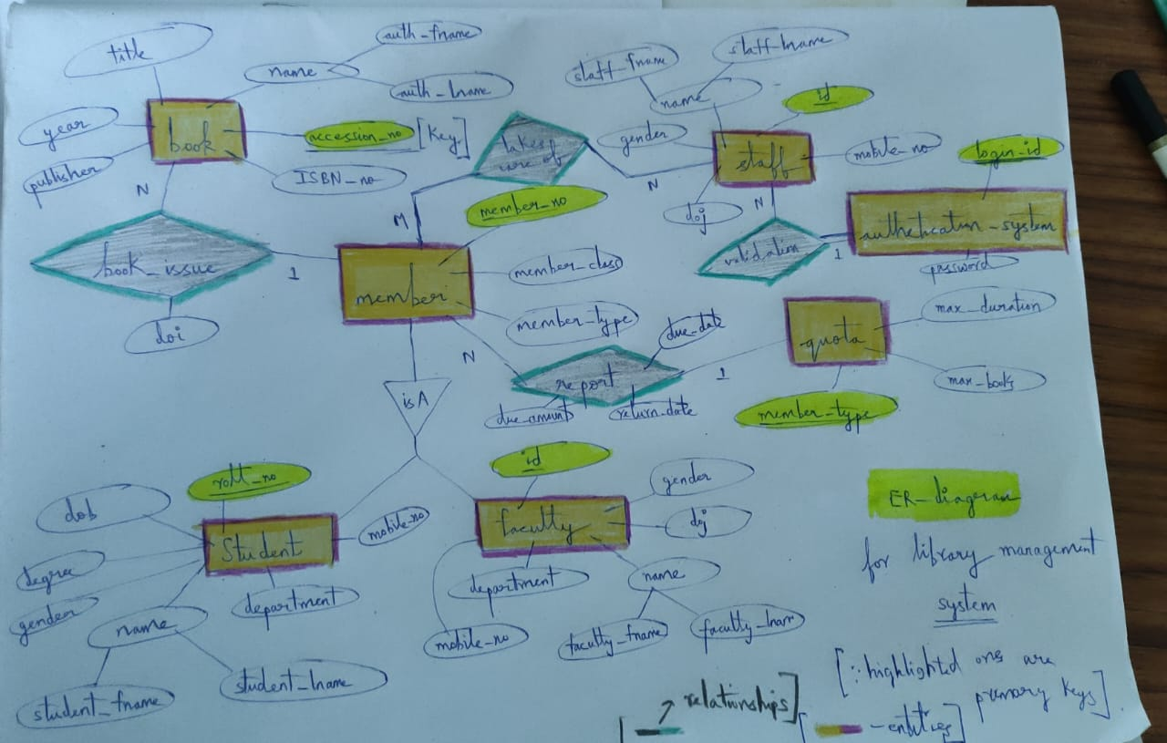
ER DIAGRAM

Slide 7
Conversion of ER DIAGRAM OF LIBRARY MANAGEMENT SYSTEM to relational schema
In the initial Schema we had 7 entity sets :-
1) books
(title, auth_fname, auth_lname, publisher ,year, ISBN_no, accession_no )
* title -> the name of the book
( there may be multiple authors but only one considered)
* auth_fname -> the first name of the author
* auth_lname -> the last name of the author
* publisher ( the person who publishes the book owns the publication)
* year( year of publication)
* ISBN_NO( unique number for every book like an ID)
* accession_no ( there may be multiple copies of each book so for every copy it is a unique id distinguishing it)
PRIMARY-KEY -> accession-no

Slide 8
Conversion of ER – DIAGRAM OF LIBRARY MANAGEMENT SYSTEM to relational schema
2) MEMBERS( member_no ,member_type ,member_class, roll_no,id)
* member_no(id of member)
* member_type ( this is for where member is undergrad,postgrad or degree or phd scholar)
* member_class ( for whether member is a student or faculty)
* roll_no ( student entity (: generalization))
* id ( from faculty)
PRIMARY-KEY -> member_no
3) QUOTA( member_type ,max_books, max_duration)
* member_type (same as the one in members)
* max_books( maximum books allocated each type of member)
* max_duration( the maximum duration possible to handle a book by a member)
PRIMARY KEY -> member_type

Slide 9
CONVERSION OF ER – DIAGRAM OF LIBRARY MANAGEMENT SYSTEM TO REALTIONAL SCHEMA
4) STUDENTS(student_fname ,student_lname , roll_no, department , gender, mobile_no, dob, degree )
* mobile_ no can have multiple values but we are considering only one for efficient database construction
* student_fname( first name of the student)
* student_lname( last name of the student)
* roll_no( unique roll_no for every student)
* department( the department where he studies)
* gender
* mobile_no
* dob
* degree ( whether the student is in postgraduation , undergarduation or a research scholar or faculty( there can be some students who can be in faculty (rarely) but considered)
PRIMARY – KEY -> {roll_no}

Slide 10
CONVERSION OF ER – DIAGRAM OF LIBRARY MANAGEMENT SYSTEM TO REALTIONAL SCHEMA
5) FACULTY
(faculty_fname, faculty_lname, id, department, gender, mobile_no, doj)
* faculty_fname( the first name of the faculty)
* faculty_lname( the last name of the faculty)
* department( the department where the faculty is from)
* id( unique id for every faculty)
* gender
* mobile_no( same there can be multiple but only one considered)
* doj( date of joining)
PRIMARY KEY -> (id)

Slide 11
CONVERSION OF ER – DIAGRAM OF LIBRARY MANAGEMENT SYSTEM TO RELATIONA SCHEMA
6) STAFF ( staff_fname, staff_lname, id, gender , mobile_no, doj )
* staff_fname( the first name of the staff)
* staff_lname( the last name of the staff)
* id( unique id given to every staff)
* gender
* mobile_no
* doj ( date of joining for every staff )
PRIMARY –KEY -> id
7) AUTHENTICATION_SYSTEM ( password, login_id) ( just for optional case)
PRIMARY_KEY -> login_id
RELATIONSHIPS ->
1) book_issue (between books and to student ,faculty, member)
many to one from books (accession_no, member_no, doi)
where doi is date of issue
2) report( from member to quota many-one) report( due_date,due_amount, return_date, member_type,member_no)

Slide 12
Conversion of ER DIAGRAM OF LIBRARY MANAGEMNET SYSTEM TO RELATIONAL SCHEMA
3) validation ( from staff to authentication_system many-one and there is total participation from authentication_system …)
validation( id, login_id, password) as ( authentication_system full participation that relationship has all its attributes )
4) takes_care_of ( from staff to members many to many)
takes_care_of ( member_no, id)

Slide 13
Scope for NORMALIZATION
In books the fd(functional dependencies are )
ISBN_no -> {title ,auth_fname ,auth_lname, publisher ,year }
accession_no -> ISBN_no
here key is accession_no the first FD is violating 3NF is a transitive depencency there is a scope of resolving it by decomposition
* book_catalogue
(title, auth_fname ,auth_lname, publisher, year, ISBN_no) and
* book_copies (ISBN_no, accession_no)
it is a lossless join decomposition and dependency preserving hence in BCNF
Quota , members , student , faculty , staff , authentication_system all in BCNF

Slide 14
Scope for Normalization…
so after applying normalization concept final schema is
1) Member( member_no, member_type, member_class, roll_no ,id)
2) Student( student_fname, student_lname, gender, roll_no, department, mobile_no, dob, degree)
3) Faculty ( faculty_fname, faculty_lname , gender , mobile_no, department , id, doj)
4) Quota(member_type, max_books, max_duration)
5) Book_catalogue( title, auth_fname ,auth_lname, publisher, year, ISBN_no)
6) Book_copies ( ISBN_no, accession_no)
7) Staff( staff_fname, staff_lname, gender, mobile_no, id, doj)
8) Authentication_System ( login_id, password)
(* the highlighted ones are primary keys of respective entity sets)
Relationships
1) book_issue( doi, accession_no, member_no) from book_copies to member(many to one)
2) Keeps_track_of(id, member_no) -> many to many from staff to member
3) Report( due_date, return_date, due_amount, member_no, member_type)
-> many to one from member to quota
4) Validation( id, login_id, password) -> many to one from staff to authentication_system

Slide 15
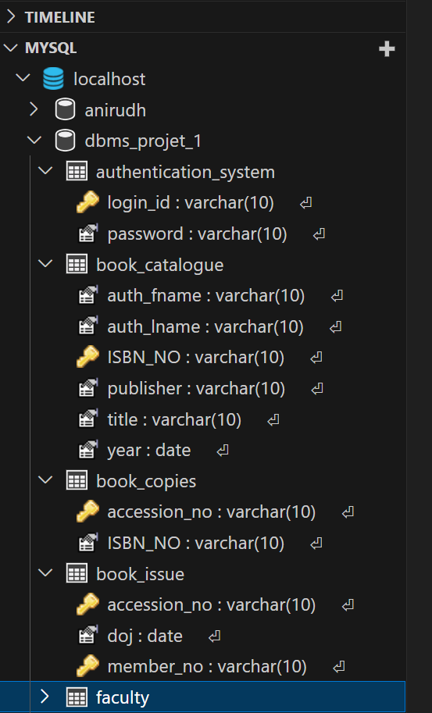
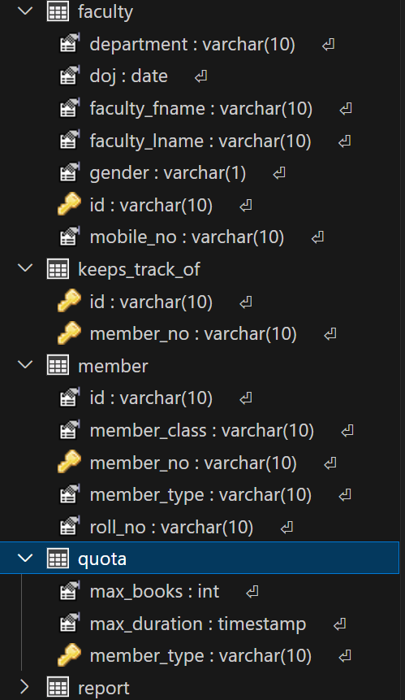
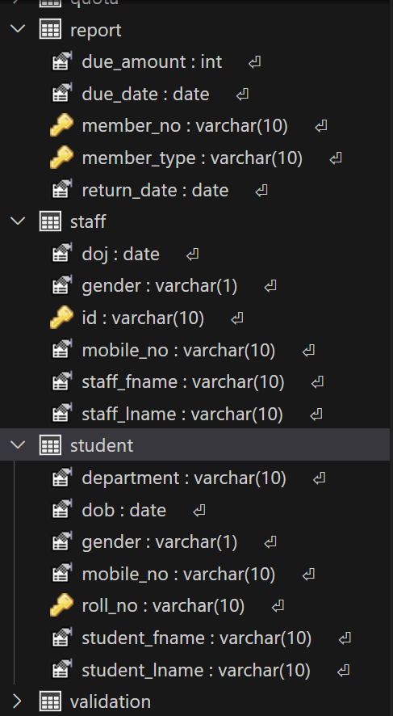
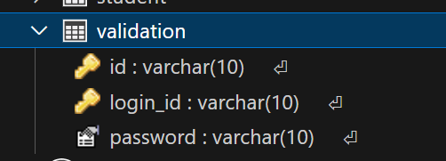
TABLE CREATION IN VS CODE

Slide 16
create table book_catalogue(
auth_fname varchar(10) NOT NULL,
auth_lname varchar(10),
title varchar(100) NOT NULL,
publisher varchar(10) NOT NULL,
year date,
ISBN_NO varchar(10) NOT NULL,
Primary key (ISBN_NO)
);
select * from book_catalogue;
create table book_copies(
ISBN_NO varchar(10) NOT NULL,
accession_no VARCHAR(10),
primary key (accession_no),
FOREIGN key (ISBN_NO) REFERENCES book_catalogue(ISBN_NO)
);
select * from book_copies;

Slide 17
create table student(
student_fname varchar(10) NOT NULL,
student_lname varchar(10),
gender varchar(1) NOT NULL,
dob DATE,
department varchar(10) NOT NULL,
mobile_no varchar(10),
roll_no varchar(10),
degree varchar(10),
check (length(mobile_no)=10),
check (department in ('CSE','ECE','EEE','BIOTECH','MME','CIVIL','MECH','INTMSC','MNC','VLSI')),
check (gender in ('M','F','O')),
primary key (roll_no)
);

Slide 18
create table faculty (
faculty_fname varchar(10) NOT NULL,
faculty_lname varchar(10),
gender varchar(1) NOT NULL,
doj DATE,
department varchar(10) NOT NULL,
mobile_no varchar(10),
id varchar(10),
check (length(mobile_no)=10),
check (department in ('CSE','ECE','EEE','BIOTECH','MME','CIVIL','MECH','INTMSC','MNC','VLSI')),
check (gender in ('M','F','O')),
primary key (id)
);

Slide 19
create table member(
member_no varchar(10) NOT NULL,
member_type varchar(10) NOT NULL,
member_class varchar(10) NOT NULL,
roll_no varchar(10),
id varchar(10),
primary key (member_no),
foreign key (roll_no) REFERENCES student(roll_no),
foreign key (id) REFERENCES faculty(id),
foreign key (member_type) REFERENCES quota(member_type)
);
CREATE table authentication_system(
login_id varchar(10) NOT NULL,
password varchar(10) NOT NULL,
check (
length(password)>=8 and
length(password)<=20
),
primary key (login_id)
);

Slide 20
create table staff(
staff_fname varchar(10) NOT NULL,
staff_lname varchar(10),
gender varchar(1),
mobile_no varchar(10),
id varchar(10),
doj date,
primary key (id),
check (gender in ('M','F','O')),
check (length(mobile_no)=10)
);
create table quota(
member_type VARCHAR(10),
max_books int,
max_duration int,
primary key (member_type)
);
-- now 8 entity sets over its time for relationship

Slide 21
create table book_issue(
member_no varchar(10),
accession_no varchar(10),
doi date,
primary key (member_no, accession_no),
foreign key (member_no) references
member(member_no),
foreign key (accession_no) references book_copies(accession_no)
);
create table report(
due_date date,
return_date date,
due_amount int,
member_no varchar(10),
member_type varchar(10),
primary key (member_no, member_type),
foreign key (member_no) references member(member_no),
foreign key( member_type) references quota(member_typ
);

Slide 22
create table validation(
login_id VARCHAR(10),
password varchar(10),
id varchar(10),
check (length(password)>=8 and length(password)<=20),
PRIMARY key (id, login_id),
foreign key (id) references staff(id),
foreign key (login_id) references authentication_system(login_id)
);
create table keeps_track_of(
id varchar(10),
member_no varchar(10),
primary key (member_no, id)
foreign key (member_no) references member(member_no),
foreign key (id) references staff(id)
);
https://github.com/Anirudh-starhash/dbms_project_1/blob/main/table_creation.sql
Git hub link for code of table creation

Slide 23
BOOK_CATALOGUE DATA
insert into book_catalogue(auth_fname ,auth_lname, title, publisher ,year ,ISBN_NO )
values
('John ',’ Doe ',’ DBMS for beginners','bell','1996-10-20','ISBN001'),
('John ',’ Smith ',’ Advanced DBMS','adam','1996-11-12','ISBN002'),
(‘ Adma ',’ Augustus ',’ Modelling and optimization techniques','david','1998-10-23','ISBN003'),
(‘Cristia ',’ Jennifer ',’ Computer Architecture','bell','1998-12-02','ISBN004'),
('John ',’ Smith ',’ Data mining','gram','1999-04-14','ISBN005'),
('Maria ',’ Smith ',’ Linux basics','ion','1999-11-03','ISBN006'),
('Henry ',’ Berkley ',’ Programming excellence','gram','2001-05-17','ISBN007'),
('Denver ',’ Daniel',’ OOPS in python','root','2001-10-21','ISBN008'),
('John ',’ Doe',’ DBMS for advanced','root','2002-06-30','ISBN009'),
('Adma ',’ Augustus',’ Machine Learning Techniques','root','2002-07-23','ISBN0010'),
(‘Aho ',’ Ullman',’ Compiler Design','willey','2002-08-15','ISBN0011'),
(‘Aho ',’ Ullman’,’ Theory of Computation','willey','2004-02-28','ISBN0012'),
(‘Tom ',’ Hardy',’ Applied physics','bell','2011-12-26','ISBN0013'),
('Jacob ',’ Williams',’ Electrical components','azmuth','2014-08-05','ISBN0014'),
('Arvind ',’ Narayan',’ How to become rich','ben','2017-12-31','ISBN0015'),
('Bala ',’ Chand',’ Cloud Computing','azmuth','2009-08-07','ISBN0016'),
('Devnath ',’ Singhal',’ English and its benefits','affleck','2008-01-11','ISBN0017'),
('Aditya',’ Kachuve',’ Block Chain Terminology','paul','2003-11-11','ISBN0018'),
('Aditi ',’ Murthy',’ Web developmemt','maria','2021-09-11','ISBN0019'),
(‘ Aradhya',’ Bisi',’ Statistics and probability','eva','2019-03-31','ISBN0020');

Slide 24
BOOK_COPIES DATA
insert into book_copies(ISBN_NO, accession_no)
VALUES
('ISBN001','ACC001'),('ISBN002','ACC002'),('ISBN003','ACC003'),('ISBN004','ACC004’),
('ISBN005','ACC005'),('ISBN001','ACC006'),('ISBN002','ACC007'),('ISBN001','ACC009’),
('ISBN003','ACC0010'),('ISBN006','ACC0011'),('ISBN007','ACC0012'),('ISBN008','ACC0013’),
('ISBN009','ACC0014’),('ISBN0010','ACC0015'),('ISBN0011','ACC0016’),
('ISBN0012','ACC0017'),('ISBN0013','ACC0018'),('ISBN0014','ACC0019'),
('ISBN0015','ACC0020'),('ISBN0016','ACC0021'),('ISBN0017','ACC0022’),
('ISBN0018','ACC0023'),('ISBN0019','ACC0024'),('ISBN0020','ACC0025’),
('ISBN0014','ACC0026'),('ISBN0014','ACC0027'),('ISBN0017','ACC0028’),
('ISBN0017','ACC0029'),('ISBN0016','ACC0030'),('ISBN0015','ACC0031’),
('ISBN0015','ACC0032'),('ISBN0012','ACC0033'),('ISBN0012','ACC0034’),
('ISBN008','ACC0035'),('ISBN007','ACC0036'),('ISBN006','ACC0037’),
('ISBN004','ACC0038'),('ISBN005','ACC0039'),('ISBN003','ACC0040’),
('ISBN001','ACC0041'),('ISBN002','ACC0042'),('ISBN0020','ACC0043'),
('ISBN0019','ACC0044'),('ISBN0018','ACC0045'),('ISBN0011','ACC0046'),
('ISBN007','ACC0047'),('ISBN006','ACC0048'),
('ISBN005','ACC0049'),('ISBN0010','ACC0050');
insert into book_copies values('ISBN002','ACC008');

Slide 25
QUOTA DATA
insert into quota (member_type, max_books max_duration )
values
('ug',6,30),
('pg',8,45),
('phd',8,50),
('fac',7,45);

Slide 26
STUDENT DATA insert into student (student_fname,student_lname,gender,dob,department,mobile_no,roll_no,degree)
VALUES
('Anirudh','Pabbaraju','M','2004-11-03','CSE','7981192166','22CSEUA10','ug'),
('Goutham','Srivastav','M','2003-12-13','ECE','7981192167','21ECEUA14','ug'),
('Shilpa','Saxema','F','2004-10-23','CSE','7981192168','22CSEPA15','pg'),
('Anil','Gupta','M','2003-09-30','MECH','7981192169','21PDC15','phd'),
('Aditi','Pittala','F','2005-11-30','MECH','7981192156','23MECHUA21','ug'),
('Abhishek','Nayar','M','2004-08-27','BIOTECH','7981192146','22BIOUA18','ug'),
('Teja','Sharma','M','2003-09-26','CIVIL','7981192136','21CIVPA13','pg'),
('Ambika','Khatri','F','2004-01-24','CSE','7981192126','22PDC10','phd'),
('Rahul','Mahadev','M','2004-03-22','EEE','7981192116','22EEEUB02','ug'),
('Nikesh','Tadela','M','2002-04-13','CSE','7981192106','20CSEUA56','ug'),
('Sai','Charan','M','2002-05-17','MNC','7981192266','20MNCPA23','pg'),
('Anunita','Bindal','F','2002-06-16','VLSI','7981192366','20PDD15','phd'),
('Akanksha','Raj','F','2004-07-15','CSE','7981192466','22CSEUA45','ug'),
('Alekhya','Boju','F','2004-12-18','VLSI','7981192566','22VLSIUA08','ug'),
('Amir','Hamza','M','2004-01-19','CSE','7981192666','22CSEPA17','pg'),
('Viraj','Perugu','M','2003-10-22','MECH','7981192766','21PDC34','phd'),
('Akshara','Hassan','F','2003-05-05','CSE','7981192866','21CSEUA15','ug'),
('Bhim','Gurjar','M','2003-06-06','ECE','7981192966','21ECEUB12','ug'),
('Vayu','Ragavan','M','2003-05-07','MNC','7981191166','21MNCPB34','pg'),
('Maya','Banerjee','F','2004-07-04','EEE','7981193166','22PDA17','phd');

Slide 27
STUDENT DATA
insert into student (student_fname,student_lname,gender,dob,department,mobile_no,roll_no,degree)
values
('Teja','Karthikeya','M','2004-07-26','CSE','9356478391','22CSEUB03','ug'),
('Anirudh','Pabbaraju','M','2004-05-24','CSE','9564783920','22CSEUA11','ug'),
('Tushar','Kumar','M','2004-08-26','ECE','9098765678','22ECEUB01','ug'),
('Pooja','Sharma','F','2004-09-18','ECE','9234567891','22ECEUB10','ug'),
('Deepti','','F','2004-10-17','BIOTECH','9567890093','22BIOUB15','ug'),
('Nikesh','Tadela','M','2004-09-25','BIOTECH','9465445679','22BIOUB21','ug'),
('Sathvika','Anagha','F','2003-08-22','MME','9657849234','22MMEUB29','ug'),
('Sathvik','Shetty','M','2004-09-12','MME','8456748321','22MMEUB28','ug'),
('Shriya','Saxena','F','2004-06-05','MECH','8675340986','22MECHUB29','ug'),
('Shika','Pandey','F','2004-08-21','MECH','7654567890','22MECHUB10','ug'),
('Tanmay','Chauhan','M','2004-02-22','CSE','8789098762','21CSEPB12','pg'),
('Manish','Chauhan','M','2004-05-21','CSE','8098765450','21CSEPA12','pg'),
('Sreenidhi','Sahay','F','2004-03-02','CSE','9876567890','20CSEPB18','pg'),
('Sanjay','Sahoo','M','2004-04-12','ECE','8123456549','21ECEPB10','pg'),
('Rajeswari','Gaikwad','F','2004-07-22','ECE','7890123455','21ECEPA02','pg'),
('Tanmay','Rao','M','2004-12-22','CSE','9856789971','21PHA12','phd'),
('Tanay','Reddy','M','2004-11-21','CIVIL','9996789545','21PDA22','phd'),
('Girija','Anand','F','2004-02-22','EEE','8874567894','21PDB32','phd'),
('Devi','Nayak','F','2004-12-11','MNC','7567890123','21PDB42','phd'),
('Shiva','Pathak','M','2004-03-12','VLSI','9087654321','21PDB12','phd');

Slide 28
FACULTY DATA
insert into faculty (faculty_fname, faculty_lname, gender, doj, department, mobile_no, id)
VALUES
('Arnav','Pandit','M','2004-11-03','CSE','7981192166','CSE10'),
('Sohel','Riyaz','M','2003-12-13','ECE','7981192167','ECE14'),
('Meera','Kant','F','2004-10-23','CSE','7981192168','CSE15'),
('Arjun','Sarja','M','2003-09-30','MECH','7981192169','PD15'),
('Amulya','Valli','F','2005-11-30','MECH','7981192156','MECH21'),
('Abhiram','Dagar','M','2004-08-27','BIOTECH','7981192146','BIO18'),
('Tejas','Joshi','M','2003-09-26','CIVIL','7981192136','CIV13'),
('Ambalika','Gupta','F','2004-01-24','CSE','7981192126','PD10'),
('Raju','Gopinath','M','2004-03-22','EEE','7981192116','EEE02'),
('Vinay','Singh','M','2002-04-13','CSE','7981192106','CSE56'),
('Sai','Karthik','M','2002-05-17','MNC','7981192266','MNC23'),
('Akshaya','Gomati','F','2002-06-16','VLSI','7981192366','PD16'),
('Avipsa','Sehgal','F','2004-07-15','CSE','7981192466','CSE45'),
('Aravi','Bisi','F','2004-12-18','VLSI','7981192566','VLSI08'),
('Mohd','Shami','M','2004-01-19','CSE','7981192666','CSE17'),
('Daniel','Ferguson','M','2003-10-22','MECH','7981192766','PD34'),
('Shruti','Hassan','F','2003-05-05','CSE','7981192866','CSE20'),
('Nakul','Singhania','M','2003-06-06','ECE','7981192966','ECE12'),
('Abdul','Sheik','M','2003-05-07','MNC','7981191166','MNC34'),
('Priya','Chaterjee','F','2004-07-04','EEE','7981193166','PD17');
AUTHENTICATION_SYSTEM DATA
insert into Authentication_system (login_id, password)
values
('priya','priya@v123'),
('Vyastyagi','tyagi@23'),
('priyanka','kavati@45'),
('PremaRani ','rani@$23'),
('Sandhya',’ rani$#21'),
('Kishore','tiru@123'),
('Tenzing','fitoor@76'),
('Aayush','singh@345'),
('Karthikeya','karthik@67'),
('Anirudh','ilraju@12'),
('Tushar','kumar@987'),
('Pooja','sharma@45'),
('Shika','pandey@67'),
('Tanmay','chauhan@11'),
('Chauhan','manish@123'),
('Sreenidhi’, ’sahay@se'),
('Gaikwad',’ gaik@raju '),
('Reddy‘ , ’reddy@tan'),
('Anand’, ’anand@giri’),
('Pathak’, 'pathak@sh');

Slide 29
insert into faculty (faculty_fname, faculty_lname, gender, doj, department, mobile_no, id)
values
('Ilaiah','Kavati','M','2007-11-27','CSE','9248291567','CSE22'),
('Sujit','Das','M','2005-06-22','CSE','9546738920','CSE12'),
('Prerna','Chopra','F','2006-10-28','BIOTECH','9234567894','BIO05'),
('Prem','Kumar','M','2007-11-27','MME','9456547890','MME23'),
('Prateek','Kumar','M','2010-03-25','CSE','7876545678','CSE25'),
('Meena','Kumari','F','2004-07-31','CSE','8345678967','CSE21'),
('Sameer','Sheik','M','2006-10-21','MNC','8123009876','MNC22'),
('Sanjay','Panda','M','2008-09-17','EEE','9765434560','EEE32'),
('Manish','Kavati','M','2009-11-27','ECE','8087654126','ECE30'),
('Vijay','Naidu','M','2004-01-08','CIVIL','9248291567','CIV12'),
('Prabhas','Raj','M','2007-11-27','CSE','9248291567','CSE31'),
('Varuni','priya','F','2007-11-27','VLSI','9248291567','VLSI22'),
('Vyas','Tyagi','M','2007-11-27','BIOTECH','9248291567','BIO09'),
('priyanka','Kavati','F','2007-11-27','CSE','9248291567','CSE65'),
('Prema','Rani','F','2007-11-27','VLSI','9248291567','VLSI01'),
('Sandhya','Rani','F','2007-11-27','ECE','9248291567','ECE05'),
('Kishore','Tirumala','M','2007-11-27','MECH','9248291567','MECH06'),
('Tenzing','Fitoor','M','2007-11-27','CSE','9248291567','CSE19'),
('Aayush','Singh','M','2007-11-27','MME','9248291567','MME17'),
('Mithali','Sherawat','F','2007-11-27','BIOTECH','9248291567','BIO11');

Slide 30
MEMBER DATA
insert into member values ('MN1','ug','stud','22CSEUA10',NULL);
insert into member values ('MN2','ug','stud','21ECEUA14',NULL);
insert into member values ('MN3','ug','stud','22CSEUA10',NULL);
insert into member values ('MN4','ug','stud','23MECHUA21',NULL);
insert into member values ('MN5','ug','stud','22BIOUA18',NULL);
insert into member values ('MN6','pg','stud','21CIVPA13',NULL);
insert into member values ('MN7','pg','stud','22CSEPA15',NULL);
insert into member values ('MN8','pg','stud','20MNCPA23',NULL);
insert into member values ('MN9','pg','stud','21MNCPB34',NULL);
insert into member values ('MN10','phd','stud','22PDA17',NULL);
insert into member values ('MN11','phd','stud','21PDB32',NULL);
insert into member values('MN12','phd','stud','21PDB12',NULL);
insert into member values ('MN13','fac','fac',NULL,'VLSI22');
insert into member values('MN14','fac','fac',NULL,'BIO09');
insert into member values('MN15','fac','fac',NULL,'CSE15');
insert into member values('MN16','fac','fac',NULL,'VLSI01');
insert into member values('MN17','fac','fac',NULL,'ECE05');
insert into member values('MN18','fac','fac',NULL,'MECH06');
insert into member values('MN19','fac','fac',NULL,'CSE19');
insert into member values('MN20','fac','fac',NULL,'MME17');
insert into member values('MN21','ug','stud','22CSEUA11',NULL);
insert into member values('MN22','pg','stud','21CSEPA12',NULL);
insert into member values('MN23','fac','fac',NULL,'PD15');
insert into member values('MN24','phd','stud','22PDC10',NULL);
insert into member values('MN25','ug','stud','22ECEUB01',NULL);

Slide 31
STAFF DATA insert into staff (staff_fname, staff_lname, gender, mobile_no, id, doj)
VALUES
('Ram','Dev','M','9704388839','STF01','2004-10-03'),
('Sravani','Reddy','F','9872843838','STF02','2005-12-04'),
('Lasya','Kumari','F','9537239271','STF03','1994-11-02'),
('Laxman','Sehgal','M','8926473777','STF04','1995-09-01'),
('Rama','Devi','F','9863673783','STF05','1996-08-21'),
('Shiv','Rathore','M','8986272728','STF06','1997-07-19'),
('Vinaya','Kaleru','F','9876543332','STF07','1998-06-18'),
('Vyshak','Kumar','M','7656890978','STF08','1999-05-17'),
('Mayanti','Langer','F','9852627272','STF09','2000-11-15'),
('Karn','Singh','M','8914378273','STF010','2002-01-14'),
('Arya','Vinod','M','9926383728','STF011','2001-02-13'),
('Mrinalini','Dube','F','7787978976','STF012','2003-04-27'),
('Aditya','Mittal','M','9876545673','STF013','2006-07-28'),
('Kashvi','Mittal','F','7976765787','STF014','2007-10-29'),
('Ramnath','Kovind','M','9876567876','STF015','1990-12-31'),
('Malaika','Reshmi','F','9128283737','STF016','1989-10-30'),
('Pritam','Garg','M','9383847383','STF017','2004-11-05'),
('Raju','Tadepalli','M','9348484574','STF018','2004-09-04'),
('Riya','Roy','F','9867687873','STF019','2003-01-23'),
('Henry','Allen','M','9876542223','STF020','2002-03-13');

Slide 32
VALIDATION DATA
insert into validation (login_id, password, id)
values
('priya','priya@v123','STF01'),
('Vyastyagi','tyagi@23','STF02'),
('priyanka','kavati@45','STF03'),
('PremaRani ','rani@$23','STF04'),
('Sandhya ',’ rani$#21','STF011'),
('Kishore','tiru@123','STF012'),
('Tenzing','fitoor@76','STF020'),
('Aayush','singh@345','STF017'),
('Karthikeya','karthik@67','STF015'),
('Anirudh','ilraju@12','STF013'),
('Tushar','kumar@987','STF07');

Slide 33
BOOK_ISSUE DATA
insert into book_issue(member_no, accession_no, doi)
values
('MN1','ACC001','2024-03-11'),
('MN11','ACC002','2024-02-11'),
('MN3','ACC003','2024-03-13'),
('MN4','ACC004','2024-03-14'),
('MN5','ACC005','2024-03-15'),
('MN6','ACC006','2024-03-16'),
('MN7','ACC007','2024-02-12'),
('MN8','ACC008','2024-02-13'),
('MN9','ACC009','2024-02-13'),
('MN10','ACC0010','2024-02-21');

Slide 34
REPORT DATA
insert into report(due_date, return_date, due_amount, member_no, member_type)
VALUES
('2024-04-11’,NULL,0,'MN1','ug'),
('2024-03-26','2024-03-27',1,'MN11','phd'),
('2024-04-13’,NULL,0,'MN3','ug'),
('2024-04-14’,NULL,0,'MN4','ug'),
('2024-04-15’,NULL,0,'MN5','ug'),
('2024-05-01’,NULL,0,'MN6','pg'),
('2024-03-27’,NULL,4,'MN7','pg'),
('2024-03-28','2024-03-29',1,'MN8','pg'),
('2024-03-28','2024-03-31',3,'MN9','pg'),
('2024-04-06’,NULL,0,'MN10','phd');

Slide 35
KEEPS_TRACK_OF DATA
insert into keeps_track_of(id, member_no)
VALUES
('STF01','MN1'),
('STF011','MN11'),
('STF02','MN3'),
('STF03','MN4'),
('STF06','MN5'),
('STF07','MN6'),
('STF09','MN7'),
('STF015','MN8'),
('STF012','MN9'),
('STF013','MN10');
https://github.com/Anirudh-starhash/dbms_project_1 github link for project -1 dbms

